Slide 1
Module 2
Marketing and Communication in the field of Sport
Notes:
One PPT should be used for each Module.

Slide 2
Module 2 : Marketing and Communication in the field of Sport
Unit 1 | Marketing and Communication in the field of Sport
Topic 1 | Definition of Marketing and Communication in the field of Sport
Topic 2 | Key elements of an effective marketing and communication plan
Topic 3 | Marketing Plan
Topic 4 | Communications tools
Notes:
You have to define the title for the Module, its Units and each Unit’s topics. You can add rows if you have more than six topics (try to not have more than 8 topics per unit) and you can add slides and copy the table to add more Units and Topics (e.g. next slide).

Slide 3
Module: Learning Outcomes
Module 6 Marketing and Communication in the field of Sport
Introduction text: The principles of sport marketing are an essential part of the professionalism required of organizations operating in the sports industry. One of the most important parts of marketing is a promotion where good communication skills make a difference for clubs and managers in general. Sports communication is the heart of the sports industry. Managers will learn and practice skills of good communication, the value of verbal and non-verbal communication. How to present and have a good pitch. The best marketing strategies and how to inspire and attract sponsors, partner organizations, etc.
Knowledge Statements of what a learner knows: | Skills Statements of what a learner understand: | Competences Statements of what a learner is able to do on completion of a learning process:
Definition and methods of marketing and communication in the field of sport | How to successfully communicate in the field of sport | Communication tools
Importance of good marketing plan | Steps for building successfull marketing plan | Implementation and designe of marketing plan

Slide 4
Introductory video
Welcome to 2 e-module. Be prepared to learn about marketing and communication in the field of sport. This module is going to explain the definition, key elements and concepts of marketing and communication. We will also discuss best practices and the importance of good marketing and communication skills in the field of sport. This module is important for all stakeholders in the field of sport as it can improve not just personal but also skills in sport organisations.
In addition, the topics will be discussed not just theoretically but also through case study and practical exercises.
In the end you will have a evaluation questioner to know check what have you learned from this module.
Enjoy the lessons!

Slide 5
Unit 1: Marketing and Communication in the field of Sport
Notes:
Define the title for the unit and use this slide for each new unit.

Slide 6
Topic 1: Definition of Marketing and Communication in the field of Sport
Marketing in the field of sport is a matching process of sport products and services to the demands of sport consumers and customers.
Pitts and Stotlar (2013, p. 82) define Sport Marketing as “the process of designing and implementing activities for the production, pricing, promotion, and distribution of a sport or sport business product to satisfy the needs or desires of consumers and to achieve the company’s objectives.”
Notes:
Define the topic’s title and the content for it. You can use more than one slides to add the content for a topic (e.g. next slide)
The content can include text, images, audio files, video files, quotes, external links, files (e.g. additional reading, resources). If you have any other types in mind, please consult us to ensure that the e-learning platform can support them.
Please ensure that all material used is copyright free and that there is no plagiarism in the material provided. All partners are responsible for the material they deliver to not bridge any copyright laws.

Slide 7
Communication in the field of Sport
Sports communication underlines the relationship development between organizations, players, fans, and third parties. Sports organizations use mixed media to improve these relationships via the internet, television, radio, and papers. Sports communication is a multi-dimensional phenomenon that includes branding, reputation management, and customer service to sales, marketing, and sponsorship.

Slide 8
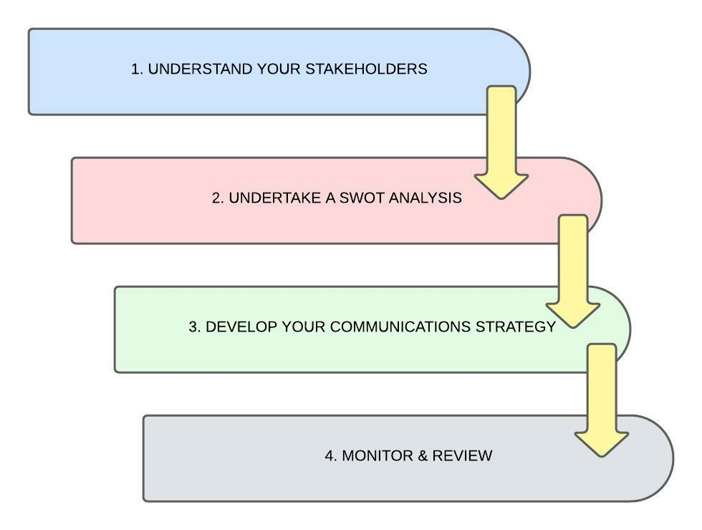
Topic 2 (continuation)
Key elements of an effective marketing and communication plan should include:
Market Research
SWOT Analysis
Marketing Objectives
To know your audience
Communication method (face-ti-fa, website, social media, email, publications, seminars, events ect.)
Monitor and Review

Slide 9
Topic 3: Marketing plan
Importance of good marketing plan- set of benefits created to satisfy consumer needs. Product and service analysis, as well as the market position, should be clearly developed in the plan.
• provide a road map for corporate development,
• assist in the management and implementation of strategy,
• communicate role specificity to new employees,
• coordinate the assignment of responsibilities and tasks,
• assist in obtaining resources for development,
• promote efficient use of resources (people, facilities, and finances),
• identify sources of competitive advantage, and
• point out problems, opportunities, and threats.

Slide 10
Topic 3 (continuation)
content

Slide 11
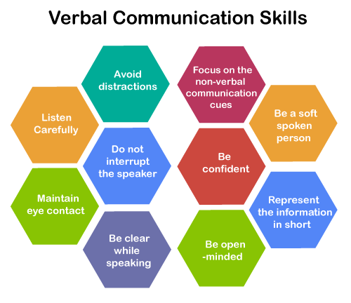
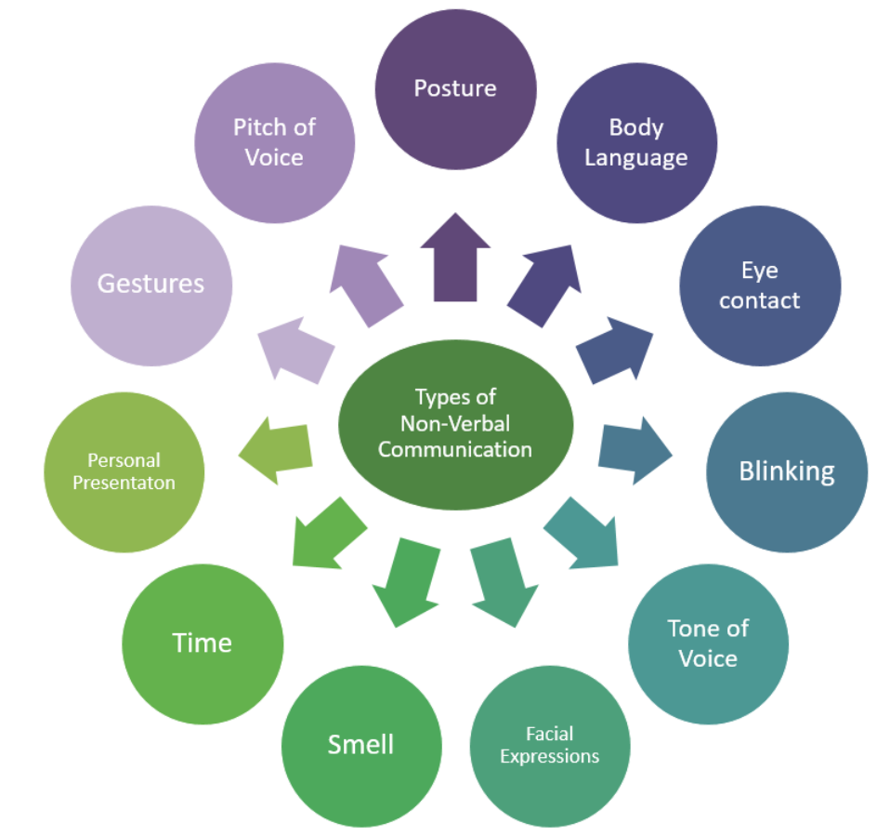
Topic 4: Communication tools
Communication processes refer to the creation and understanding of meaning through exchanging verbal and nonverbal messages.
Nonverbal Communication Skills

Slide 12
Factors to successful communication
Listening
Verbal Communication
Nonverbal Communication
Emotional Awerness
Written Communication
Communication in Difficult Situation

Slide 13
Learning Activity 1: Elevator pitch
30 seconds to present themselves by saying the most important things and to intrigue the interest of the listener
It is a short description of an idea, product, or company that explains the concept in a way such that any listener can understand it in a short period of time.
An elevator pitch usually explains what is the idea, product, company, or person and its value.
The elevator pitch can be used to attract sponsors either in a job interview or to explain an idea to department heads. The goal is to simply convey the whole concept or topic in an exciting way.

Slide 14
Learning Activity 2: Sport Marketing
Educational goal | Type of activity | Content | Additional materials
Search, select and analyze two sport-related advertisements, one weak and one strong | Individual exercise | After revising the Unit 1, develop the statements detailed in the handout.

Slide 15
Evaluation
Notes:
Define the question.

Slide 16
Question 1
Type : Multiple choice
Question : What are the key elements of an effective marketing and communication plan?
SWOT Analysis
Nonverbal communication
Maitain the eye contact
Notes:
Define the question.

Slide 17
Question 2
Type : Multiple choice (Single answer)
Question : What is the communication process about?
Answers:
Verbal communication
Marketing Mix
Promotion
Notes:
Define the question. You can add as many answers as you want but define the one that it is correct.

Slide 18
Question 3
Type : Multiple choice (Multiple answers)
Question : What are the 4 P of Marketing Mix?
Answers:
Product
Posture
Price
Play
Notes:
Define the question. You can add as many answers as you want.

Slide 19
Question 4
Type : Matrix Sorting
Question : Match the skills with the type
Right Answers:
Nonverbal communication | Avoid distraction
 | Body language
 | Be confident
 | Blinking
Verbal communication | Posture
 | Eye contact
Notes:
Define the question. Create a table with two columns and fill them with pairs. The first cell in the first column must match the first cell in the second column. The system will then shuffle the options when presenting them.

Slide 20
Question 5
Type : Assessment (Select from the list)
Question : From 1 to 5 how intrested was the topic presented in the Module?
Right Answers:
{[1][2][3][4][5]}

Slide 21
Summary
Sports communication is the heart of the sports industry.
With good communication, a lot can be achieved in the world of sports. It is important to recognize the opportunity and present yourself and the organization.
The organizations that are most likely to survive is the one that will adapt to the needs and wants of the customers. To accomplish that you need a well-defined marketing plan.
Efforts of increasing income of sport clubs, because of sport organization popularity, either media or sports business started to focus on marketing structure like other business services.
Sport teams and sport clubs of all sizes and at different levels and sectors in sport industry have to engage in marketing activities in order to present their products and services to the market
Notes:
An evaluation can also be an option by setting some close ended questions.
To be further discussed and agreed upon during our next meeting.

Slide 22
Further material
Strategic communication in Sport
https://books.google.hr/books?hl=en&lr=&id=LObsDwAAQBAJ&oi=fnd&pg=PP2&dq=marketing+and+communication+in+sport&ots=FkLylu6RTm&sig=cGf_lLcvBIadvk8tgDxC3F8Je9U&redir_esc=y#v=onepage&q=marketing%20and%20communication%20in%20sport&f=false
Marketing in Sport
https://books.google.hr/books?hl=hr&lr=&id=woJEDgAAQBAJ&oi=fnd&pg=PP1&dq=marketing+and+communication+in+field+of+sport&ots=VoJp6IGxCc&sig=iuYXIG0w3F9NkHMqFluJok4fNNw&redir_esc=y#v=onepage&q=marketing%20and%20communication%20in%20field%20of%20sport&f=false
Notes:
You can either divide them per unit or for the whole module.

Slide 23
Case study
https://www.studocu.com/en-au/document/swinburne-university-of-technology/introduction-to-sports-business-management/sports-marketing-case-study-seminar-assignments-assessment-3/481695
https://www.studocu.com/en-au/document/swinburne-university-of-technology/sports-marketing/seminar-assignments-assessment-4-sports-marketing-plan/481694

Slide 24
References
Mohammadkazemi, R. (2020.), Sports Marketing and Social Media. In N. Hajli (Newcastle University Business School), Handbook of Research on Integrating Social Media into Strategic Marketing, Business Science.
Pedersen, M.P., Laucella, L.C., Kian, E.M., Geurin, A.N (2021.), Strategic Sport Communication, Human Kinetics
Blakey, P. (2011.), Sport Marketing, Learning Matters
Pitts, B.G. & Stotlar D.K, (2013.), Fundamentals of Sport Marketing 4th edition
Notes:
For referencing and other editorial-related aspects of the research please apply only the APA Citation Style Guide. This is both to safeguard the scientific quality of the overall research of the project as well as to ensure that there is a stylistic uniformity amongst the reports submitted by partners.

