Slide 1
Gute Regierungsführung
Modul 1
612986-EPP-1-2019-1-DE-SPO-SCP

Slide 2
Theoretische Einführung
Nationale Governance-Anforderungen für den Sport
612986-EPP-1-2019-1-DE-SPO-SCP
Notes:
In 2004, the Council of Europe /CE/ was the first intergovernmental organisation which highlight the importance of Good Governance in Sport;
The Recommendation follows the Resolution No. 1 on the principles of Good Governance in Sport adopted in 2014 at the 10th Conference of European Ministers of sport;
The recommendation defines good governance as: “a complex network of policy measures and private regulations used to promote integrity in the management of the core values of sport such as democratic, ethical, efficient and accountable sports activities”.

Slide 3
Gutes Regieren ist Sport IO 3
Theoretische Einführung
Empfehlung Rec(2005)8 des Ministerkomitees an die Mitgliedstaaten zu Good Governance im Sport
https://rm.coe.int/09000016808ec28f
612986-EPP-1-2019-1-DE-SPO-SCP
Notes:
Good Governance in Sport which include the following requirements: “democratic structures for non-governmental sports organisations based on clear and regular electoral; procedures open to the whole membership; organisation and management of a professional standard, with an appropriate code of ethics and procedures for dealing with conflicts of interest; accountability and transparency in decision-making and financial operations, including the open publication of yearly financial accounts duly audited; fairness in dealing with membership, including gender equality and solidarity”.

Slide 4
Gutes Regieren ist Sport IO 3
Theoretische Einführung
Was ist gute Regierungsführung?
612986-EPP-1-2019-1-DE-SPO-SCP
Notes:
Governance refers to all processes of governing, the institutions, processes and practices through which issues of common concern are decided upon and regulated;
Good governance adds a normative or evaluative attribute to the process of governing;
From a human rights perspective it refers primarily to the process whereby public institutions conduct public affairs, manage public resources and guarantee the realization of human rights.

Slide 5
Gutes Regieren ist Sport IO 3
Theoretische Einführung
STAATLICHE BEHÖRDEN
612986-EPP-1-2019-1-DE-SPO-SCP
Notes:
Acknowledging that public authorities have a key role to play in promoting the implementation of good governance principles;
Being aware that effective prevention of and response to corruption in sport may call for changes in legislation and policies, but also in social attitudes towards corruption in the private sector, Recommends that the governments of member States facilitate, support and follow up the implementation of good governance in sport, in particular in order to strengthen the fight against corruption in sport.

Slide 6
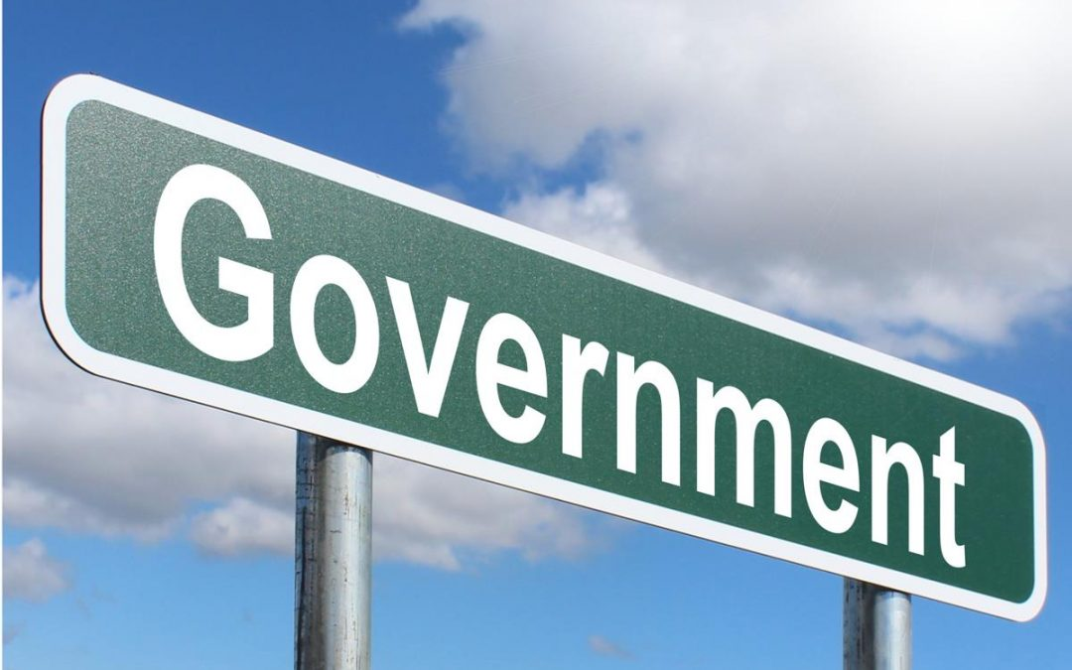
Gutes Regieren ist Sport IO 3
Theoretische Einführung
DIE REGIERUNG
612986-EPP-1-2019-1-DE-SPO-SCP
Notes:
Governments have the obligation to promote and protect human rights and to guarantee respect for the rule of law also in the context of sports organizations. They also have a vested interest in promoting good governance in sport, in particular because:
governments are involved in preventing and responding to threats against the integrity of sport and to violations of the human rights of those participating in sports activities;
governments support sports activities and the participation of athletes or teams representing national sports organizations in international competitions;
governments invest in hosting events or bidding to host events;
public broadcasters buy certain broadcasting rights.

Slide 7
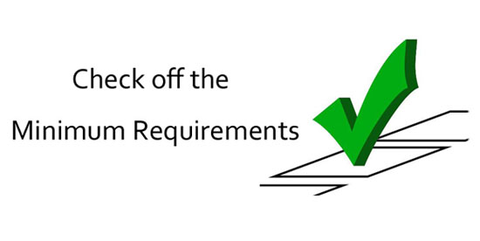
Gutes Regieren ist Sport IO 3
Theoretische Einführung
GUTE REGIERUNGSFÜHRUNG IM SPORT MINDESTANFORDERUNG
612986-EPP-1-2019-1-DE-SPO-SCP
Notes:
Recommendation Rec(2005)8 on the principles of good governance in sport states that effective policies and measures of good governance in sport include as a minimum requirement:
democratic structures for non-governmental sports organizations based on clear and regular electoral procedures open to the whole membership;
organization and management of a professional standard, with an appropriate code of ethics and procedures for dealing with conflicts of interest;
accountability and transparency in decision making and financial operations, including the open publication of duly audited yearly financial accounts;
fairness in dealing with membership, including gender equality and solidarity.

Slide 8
Gutes Regieren ist Sport IO 3
Theoretische Einführung
Auf dem Gebiet der Good Governance im Sport wurden die folgenden Schritte unternommen
612986-EPP-1-2019-1-DE-SPO-SCP
Notes:
The 2007 White Paper on Sport noted that self-regulation is able to deal with most challenges that affect sport if good governance principles are being applied;
In its 2011 Communication (Developing the European Dimension in Sport) the Commission took a more elaborate position, noting that good governance in sport is a condition for the autonomy and self-regulation of sport organizations;
In 2011, the topics of good governance and strengthening the organization of sport in Europe were included in the Preparatory Actions in the field of sport. Eight projects were selected, implemented, and concluded by the end of 2013;
An EU Expert Group on Good Governance was established on the basis of the Council Resolution on an EU Work Plan for Sport 2011-2014. In October 2013, the Group adopted recommendations on the Principles for Good Governance of Sport in the EU and presented them to the EU Council.
In 2016, Flagship event on good governance in sport has been conducted and a Pledge on good governance in sport has been launched and supported by 32 sport organizations in Europe.
An integrated approach to Sport Policy: good governance, accessibility and integrity report has been accepted from the EP and also has been main topic of Sport Forum 2017, held during the Maltese presidency. During the event, project applicant BSDA has signed the pledge to implement good governance principles in grassroots sport.

Slide 9
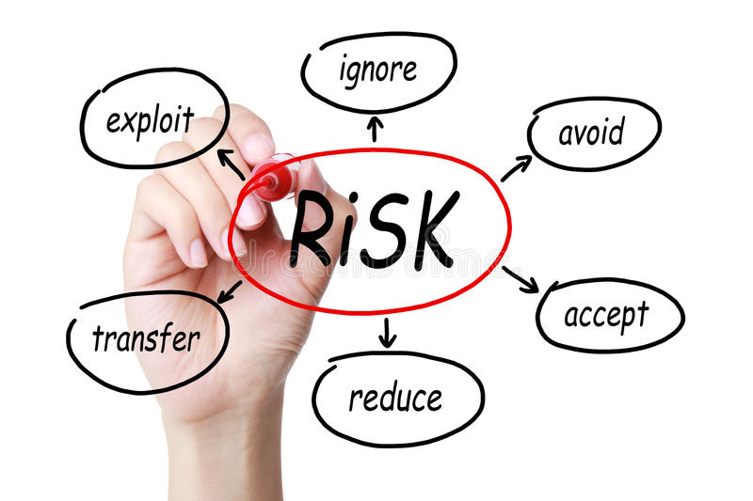
Gutes Regieren ist Sport IO 3
Theoretische Einführung
DAS RISIKO VERRINGERN
612986-EPP-1-2019-1-DE-SPO-SCP
Notes:
Due to recent and recurring high-profile corruption scandals, International Sports Organizations are put increasingly under public scrutiny. In order to reduce the risk of other possible unethical behavior, restore public trust, and maintain their autonomy, are expected to respect good governance principles.

Slide 10
Gutes Regieren ist Sport IO 3
Theoretische Einführung
DAS RISIKO VERRINGERN
612986-EPP-1-2019-1-DE-SPO-SCP
Notes:
Good Governance is an approach to government that is committed to creating a system founded in justice and peace that protects individual’s human rights and civil liberties. According to the United Nations, Good Governance is measured by the eight factors of:
Participation;
Rule of Law;
Transparency;
Responsiveness;
Consensus Oriented;
Equity and Inclusiveness;
Effectiveness and Efficiency;
Accountability.

Slide 11
Gutes Regieren ist Sport IO 3
Grundsätze der guten Regierungsführung
PARTNERSCHAFT
REGEL DES RECHTS
TRANSPARENZ
612986-EPP-1-2019-1-DE-SPO-SCP
Notes:
Participation requires that all groups, particularly those most vulnerable, have direct or representative access to the systems of government. This manifests as a strong civil society and citizens with the freedom of association and expression;
Rule of Law is exemplified by impartial legal systems that protect the human rights and civil liberties of all citizens, particularly minorities. This is indicated by an independent judicial branch and a police force free from corruption;
Transparency means that citizens understand and have access to the means and manner in which decisions are made, especially if they are directly affected by such decisions. This information must be provided in an understandable and accessible format, typically translated through the media;

Slide 12
Gutes Regieren ist Sport IO 3
Grundsätze der guten Regierungsführung
REAKTIONSFÄHIGKEIT
KONSENSORIENTIERT
GLEICHBERECHTIGUNG UND INKLUSION
612986-EPP-1-2019-1-DE-SPO-SCP
Notes:
Responsiveness simply involves that institutions respond to their stakeholders within a reasonable time frame;
Consensus Oriented is demonstrated by an agenda that seeks to mediate between the many different needs, perspectives, and expectations of a diverse citizenry. Decisions needs to be made in a manner that reflects a deep understanding of the historical, cultural, and social context of the community;
Equity and Inclusiveness depends on ensuring that all the members of a community feel included and empowered to improve or maintain their

Slide 13
Gutes Regieren ist Sport IO 3
Grundsätze der guten Regierungsführung
WIRKSAMKEIT UND EFFIZIENZ
RECHENSCHAFTSPFLICHT
612986-EPP-1-2019-1-DE-SPO-SCP
Notes:
Effectiveness and Efficiency is developed through the sustainable use of resources to meet the needs of a society. Sustainability refers to both ensuring social investments carry through and natural resources are maintained for future generations.
Accountability refers to institutions being ultimately accountable to the people and one another. This includes government agencies, civil society, and the private sector all being accountable to one another as well.

Slide 14
Gutes Regieren ist Sport IO 3
DANKE FÜR IHRE AUFMERKSAMKEIT!!!
HABEN SIE NOCH FRAGEN?
612986-EPP-1-2019-1-DE-SPO-SCP

Slide 15
Referenzen
Bulsport. (n.d.). #GoodGovernance - European everyday of sport. Www.eusport.org. Retrieved April 27, 2022, from https://www.eusport.org/goodgovernanceCarolaM. (2021, October 14).
What is Good Governance? Creative Learning. http://creativelearning.org/blog/2021/10/14/what-is-good-governance/Committee of Ministers. (2005).
Recommendation Rec(2005)8 of the Committee of Ministers to member States on good governance in sport. Https://Rm.coe.int. https://rm.coe.int/09000016808ec28fMrkonjic, M. (2016).
A review of good governance principles and indicators in sport. https://www.icsspe.org/system/files/EPAS%20-%20Review%20of%20Good%20Governance%20principles%20and%20indicators%20in%20sport.pdf
612986-EPP-1-2019-1-DE-SPO-SCP

