Slide 1



Digital Skills for Marketing Managers
Module 3
612986-EPP-1-2019-1-DE-SPO-SCP

Slide 2
DIGITAL TOOLS AND MOST IMPORTANT SOCIAL MEDIA PLATFORMS
RELEVANCE AND BRANDING ADVICES
612986-EPP-1-2019-1-DE-SPO-SCP

Slide 3
The relevance
WHY AND HOW DIGITAL TOOLS AND SOCIAL MEDIA CAN IMPROVE THE IMAGE OF OUR TEAM AND ACTIVITIES?
Digital technologies are increasingly present in the daily lives and have a huge impact on people and on all aspects of human life, also on business sector.
Over time, companies began to take advantage of the benefits of the modern digital age, especially when they promote their brand. Their business processes and relations with the customers are based on the use of digital technologies so they can easily get to know them, their brand (namely their values, products and services) and get in touch with them. On the other hand, clients can learn more about the company and their activity and can compare their experiences and thoughts for certain products and services.
612986-EPP-1-2019-1-DE-SPO-SCP

Slide 4
BENEFITS OF USING DIGITAL TOOLS
Measurable results. We cannot count how many people have seen the billboard or how many people have read the flyer, but through digital tools, we can get solid and real results that show us exactly how many people have clicked a certain link and read the web age. This will help us to focus on the segment where do our potential clients come from.
Flexibility. The clients nowadays are interested for personalized experiences that satisfy their needs. Here we can single out digital marketing as it enables us to take advantage of the interests of individual clients and send them a unique message.
612986-EPP-1-2019-1-DE-SPO-SCP

Slide 5

3. Access to a larger audience. Through digital tools, we can reach a large and global audience thanks to the internet that is present in every country.
4. Greater and easy availability. Digital tools are generally free of charge and, through them, every company has the ability to reach any audience regardless of how great they are.
612986-EPP-1-2019-1-DE-SPO-SCP
Questa foto di Autore sconosciuto è concesso in licenza da CC BY-NC-ND

Slide 6
DIGITAL TOOLS AND SOCIAL MEDIA CHANNELS FOR SUCCESSFUL BRANDING PROCESS
DIGITAL TOOLS
ZOOM
ASANA or TRELLO
WEBSITE or BLOG
MAILCHIMP
CANVA
612986-EPP-1-2019-1-DE-SPO-SCP

Slide 7



ZOOM
When building our personal brand, we will want to be able to connect with team members, clients, and fans easily from our own personal computer. Zoom could be an excellent tools for this. This platform give us the ability to use video and audio and to share our screen. Zoom has a Free option that allows up to 100 participants, and 40mins total per call, and several paid plans that provide unlimited call times, more controls, reporting, and even some custom branding options.
ASANA or TRELLO
Organization is one of the keys to branding yourself successfully. Asana or Trello can help us to keep our whole brand and team on track. We can use it to organize our tasks, assign them to team members, set due dates, and collaborate, all in one place. Even if we are a team of one, this tool can help us to visualize everything we need to do and motivate us to get it done on time.
612986-EPP-1-2019-1-DE-SPO-SCP

Slide 8


WEBSITE or BLOG
One of the strongest internet marketing communication tools is a functional web page or team blog that fans can easily access. They must be functional, informative, use simple navigation and keep them up to date about teams' events and more.
MAILCHIMP
Email marketing is a great way to engage our audience and boost our brand. Mailchimp makes this simple, with hundreds of templates to choose from, analytics to help us track our success and audience segmentation to enable us to tailor our emails to the needs of each audience.
612986-EPP-1-2019-1-DE-SPO-SCP

Slide 9

CANVA
If we want to exist in a digital space, then we need visuals because they engage our audience. And Canva is one of the top tools to do this.
Canva has pre-made sizes for social media and other digital spaces you need, as well as thousands of templates and free images. You’ll have all the tools you need to create beautiful visuals. And with a handy free version, Canva is accessible to everybody, no matter their budget.
612986-EPP-1-2019-1-DE-SPO-SCP

Slide 10

SOCIAL MEDIA PLATFORMS
Social networks on the internet are an area where people who share common connections can interact with each other. Some of the leaders here are:
FACEBOOK
INSTAGRAM
TWITTER
TELEGRAM
Many others…
Together occupy for 90% of the total internet activity. Social network visitors are just one way of measuring the impact of social networks. The reviews of the pages, the time spent on them, the attention, as well as the frequency of the visits. Today, social networks are turning into huge, rich businesses.
612986-EPP-1-2019-1-DE-SPO-SCP

Slide 11

BRANDING ADVICES
Create consistent messaging: the core of brand building on social media largely involves creating themes — or messages — and regularly demonstrating them through text and visuals. What we do want to make sure is that we have a consistent logo, color palette, bio, boilerplate and handle. Let’s see an example!
612986-EPP-1-2019-1-DE-SPO-SCP

Slide 12
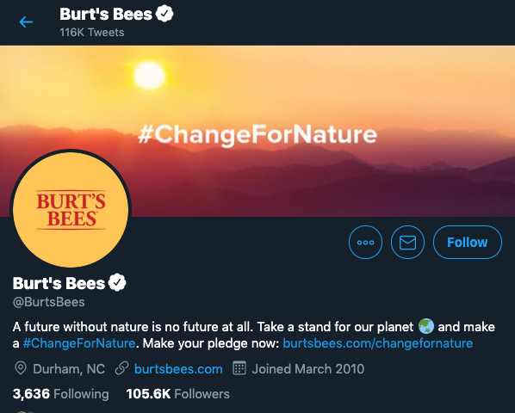
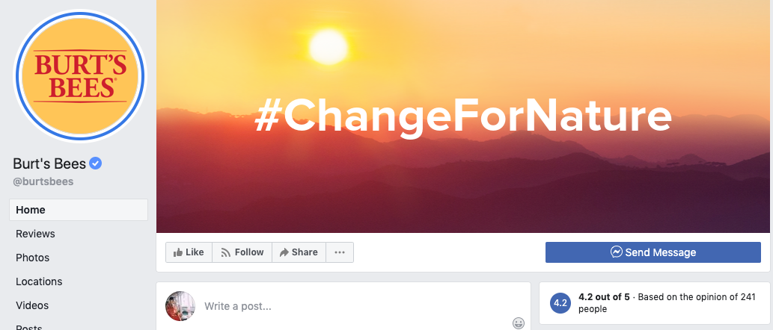
In the above example, Burt’s Bees uses the same logo for both Facebook and Twitter. Their banners are also the same. It isn’t always necessary for the two banners to be the same on every network, but this approach succeeds because even the colors in the banners reflect those in the logo.
612986-EPP-1-2019-1-DE-SPO-SCP

Slide 13

TIPS
Perform a social media audit across all of your accounts;
Ensure logos, banners, bios, posting cadences and handles are consistent with your brand guidelines, and audit regularly.
612986-EPP-1-2019-1-DE-SPO-SCP

Slide 14
2. Extension of visual branding: now that we have a consistent visual brand across network accounts, it’s time to ensure we have the same colors and fonts reflected in our images, graphics and videos. When someone visits your Instagram page, is the filter or pop of color immediately apparent to them? When a video is published, are the overlay text fonts similar to those that you use for your blog post’s featured image? Over time, our followers will see the consistency in posts and begin to recognize when a post is from us without seeing our brand’s logo or social media handle.
TIPS
Create graphic templates for the same type of announcement (e.g. new product announcement has a similar font, color and design);
Create photos and videos that keep your brand’s aesthetic and color choices in mind. The posts should flow seamlessly into each other.
612986-EPP-1-2019-1-DE-SPO-SCP

Slide 15
3. Identification of marketing personas: our marketing personas are going to vary between the networks. For example, audiences on TikTok are younger than audiences on Facebook. This means that our social contents won’t resonate the same way. To this end, it’s best to create multiple personas.
TIPS
Create multiple marketing personas and assign the social media networks that match;
Examine your networks’ different demographics or set up listening queries if you need to get to know your audience;
Create content to match the personas.
612986-EPP-1-2019-1-DE-SPO-SCP

Slide 16
4. Definition of our brand voice and tone: after visuals, captions and related copy are the next important piece of branding our social media posts. Each company or sport team tend to have a personality, a brand voice for its marketing focuses. Extending them to social media is highly recommended because they create connections and immediate recognition of our team or company.
TIP
A voice and tone guide should include details like brand persona, company catchphrases, personality traits and vocabulary. The smallest details, like whether you use the term “fans” or “customers” will help you keep your writing consistent. If you have multiple people managing your accounts, having a guide to reference keeps your team aligned so it doesn’t seem like your company is writing from disparate perspectives.
612986-EPP-1-2019-1-DE-SPO-SCP

Slide 17
5. Contents organization and sharing: since social media branding centres on influencing our audience to easily recognize and remember us, irregular posting damages our efforts by keeping us off user newsfeeds. Posting frequency depends on audience activity and how audience members engage.
TIPS
Set your social media goals: how many posts published, how many people reached, how frequently to share, what kind of contents (videos, photos, articles, news etcetc) to publish…
Create an editorial plan and a calendar to organize the publication of your contents and follow it. You can use social media management apps that help you organize the upcoming social media posts in Google calendar, spreadsheets, and interactive dashboards.
Check the interactions (likes, comments…) and the analytics under your posts and, if necessary, correct your publication strategy to increase the engagement.
612986-EPP-1-2019-1-DE-SPO-SCP

Slide 18
OTHER TIPS
Connect with local or national influencers: the first step in executing an influencer marketing campaign is identifying suitable influencers, namely influencers with real followers’ engagement. The next step is building a relationship with an influencer who matches your criteria. You can start by following target influencers on their main social channels, interacting with their updates and sharing their content. Once you’ve built some rapport, you can, for example, invite the influencers to your sport meetings.
Create giveaways: for example, you can give away a t-shirt of your football team, inviting people online to share and like the posts of your Instagram accounts. This will ensure you visibility, interactions and brand recognition.
Join online communities or groups: groups and virtual communities let you directly engage members of your target market to create buzz around your brand’s ideas, opinions and content. You can share posts and stimulate debates under them, giving more visibility to your team.
612986-EPP-1-2019-1-DE-SPO-SCP

Slide 19
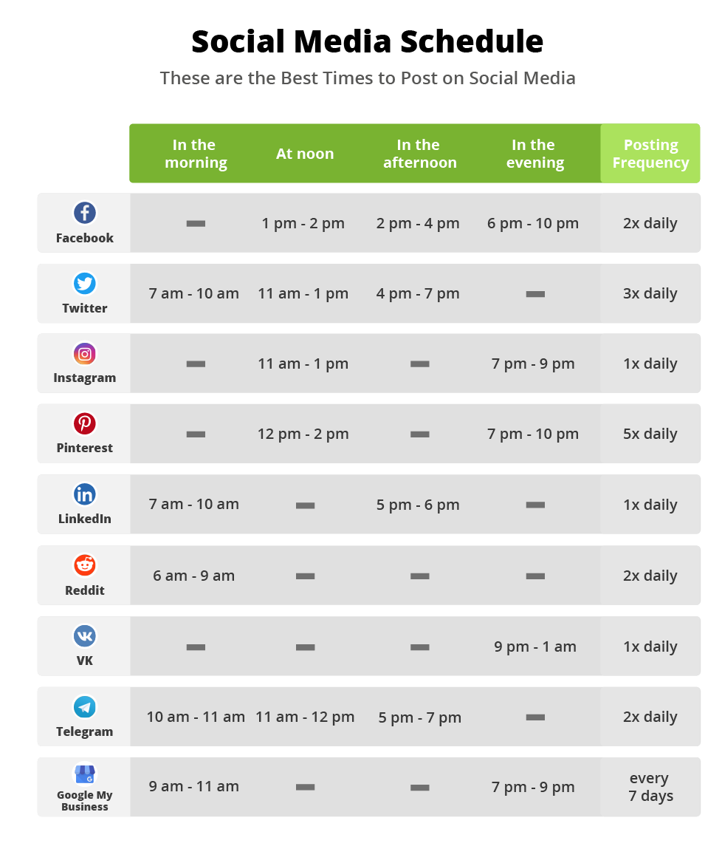
Share your posts in specific moments: some studies illustrated which are the best moments in which sharing contents on social media. We suggest you to follow these indications.
Source: Blog2Social
612986-EPP-1-2019-1-DE-SPO-SCP

Slide 20

REFLECT:
What kind of digital tools do you think you're going to use? Why?
Did you already know or use some of them? Which ones?
Which digital tools or social media do you think are the best for your needs?
Imagine a brand marketing strategy for their team: what would they do? Which branding advices do they want to implement and how?
612986-EPP-1-2019-1-DE-SPO-SCP

Slide 21
References
Articles
Aydin, G.; Uray, N.; Silahtaroglu, G. How to Engage Consumers through Effective Social Media Use—Guidelines for Consumer Goods Companies from an Emerging Market. J. Theor. Appl. Electron. Commer. Res. 2021, 16, 768–790. https://doi.org/10.3390/Jtaer16040044
Blazheska D., Ristovska N, Gramatnikovski S. (2020). The Impact of Digital Trends on Marketing. UTMS Journal of Economics 11(1) (pp. 48–58).
Vinerean S. (2016). Branding Strategies for Social Media Marketing. Expert Journal of Marketing, Volume 4, Issue 2, (pp.77-83).
Guides
Hootsuite. Social Media Strategy Guide - Eight easy steps to develop your social media presence
612986-EPP-1-2019-1-DE-SPO-SCP

Slide 22
Websites
WP Wings, 23 Tips For Building A Brand Through Social Media Platforms: https://wpswings.com/blog/effective-tips-building-brand-social-media-strategy/
KeyHole, Social Media Branding Strategies to Capture and Retain Your Target Audience: https://keyhole.co/blog/15-social-media-branding-strategies/
Sprout social, 5 actionable strategies for social media branding: https://sproutsocial.com/insights/social-media-branding/
612986-EPP-1-2019-1-DE-SPO-SCP

Slide 23



GENERAL DATA PROTECTION REGULATION (GDPR)
THEORICAL BACKGROUND AND FUNDAMENTAL ASPECTS
612986-EPP-1-2019-1-DE-SPO-SCP

Slide 24

Introductory video
https://www.youtube.com/watch?v=gnyXWM7sm8Y
612986-EPP-1-2019-1-DE-SPO-SCP

Slide 25
THEORICAL BACKGROUND
WHAT IS GDPR?
“Regulation (EU) 2016/679 of the European Parliament and of the Council¹, the European Union’s ('EU') new General Data Protection Regulation (‘GDPR’) regulates the processing by an individual, a company or an organisation of personal data relating to individuals in the EU.”
European Commission, 2016
612986-EPP-1-2019-1-DE-SPO-SCP

Slide 26
WHAT ARE PERSONAL DATA?
Personal data in the context of the GDPR refers to all data (names, genetic, biometric or health data, web data such as IP addresses, personal email addresses, political opinions and sexual orientation) relating to an identified or identifiable living person. It also includes information which, when collected together, may lead to the identification of that person. This also applies to data that is encrypted or presented using pseudonyms, as long as the encryption/anonymisation is reversible. In compliance with the obligations of the Data Protection Regulation, this means that decryption keys must be kept separate from pseudonymised data.
612986-EPP-1-2019-1-DE-SPO-SCP

Slide 27
PRIVACY: A DEFINITION
Broadly speaking, privacy is the right to be let alone, or freedom from interference or intrusion. On legal side, we can talk about the information privacy, namely the right to have some control over how your personal information is collected and used.
With speed-of-light technological innovation, information privacy is becoming more complex by the minute as more data is being collected and exchanged. As the technology gets more sophisticated (indeed, invasive), so do the uses of data. And that leaves organizations facing an incredibly complex risk matrix for ensuring that personal information is protected. As a result, privacy has fast-emerged as perhaps the most significant consumer protection issue (if not citizen protection issue) in the global information economy.
This took to development of the data privacy concept: it is focused on the use and governance of personal data, things like putting policies in place to ensure that consumers’ personal information is being collected, shared and used in appropriate ways. Security focuses more on protecting data from malicious attacks and the exploitation of stolen data for profit.
612986-EPP-1-2019-1-DE-SPO-SCP

Slide 28
WHICH ARE THE PARTS INVOLVED?
User: an individual whose personal data is processed by a controller or processor (also known as the data subject).
Data controller: any person or legal entity involved in determining the purpose and ways of processing the personal data.
Data processor: any person or legal entity involved in processing personal data on behalf of the controller.
For example, an internet company may collect user information via their website and store it using a 3rd party cloud service. In this scenario, the internet company is the data controller and the organization running the cloud service is the data processor.
612986-EPP-1-2019-1-DE-SPO-SCP

Slide 29
WHAT ARE THE POSITIVE ELEMENTS OF GDPR?
With this Regulation, the European Council redefines the approach of organizations to data protection, in view of the constant cyber attacks that entities of all sizes and sectors have been subjected to for some years now, providing useful guidance in this direction.
The main advantages of the GDPR are:
single rules for the whole EU;
level playing field for all EU companies;
rules adapted to the web-economy;
scalable" and "adaptable" rules to technological changes and future economic scenarios.
612986-EPP-1-2019-1-DE-SPO-SCP

Slide 30
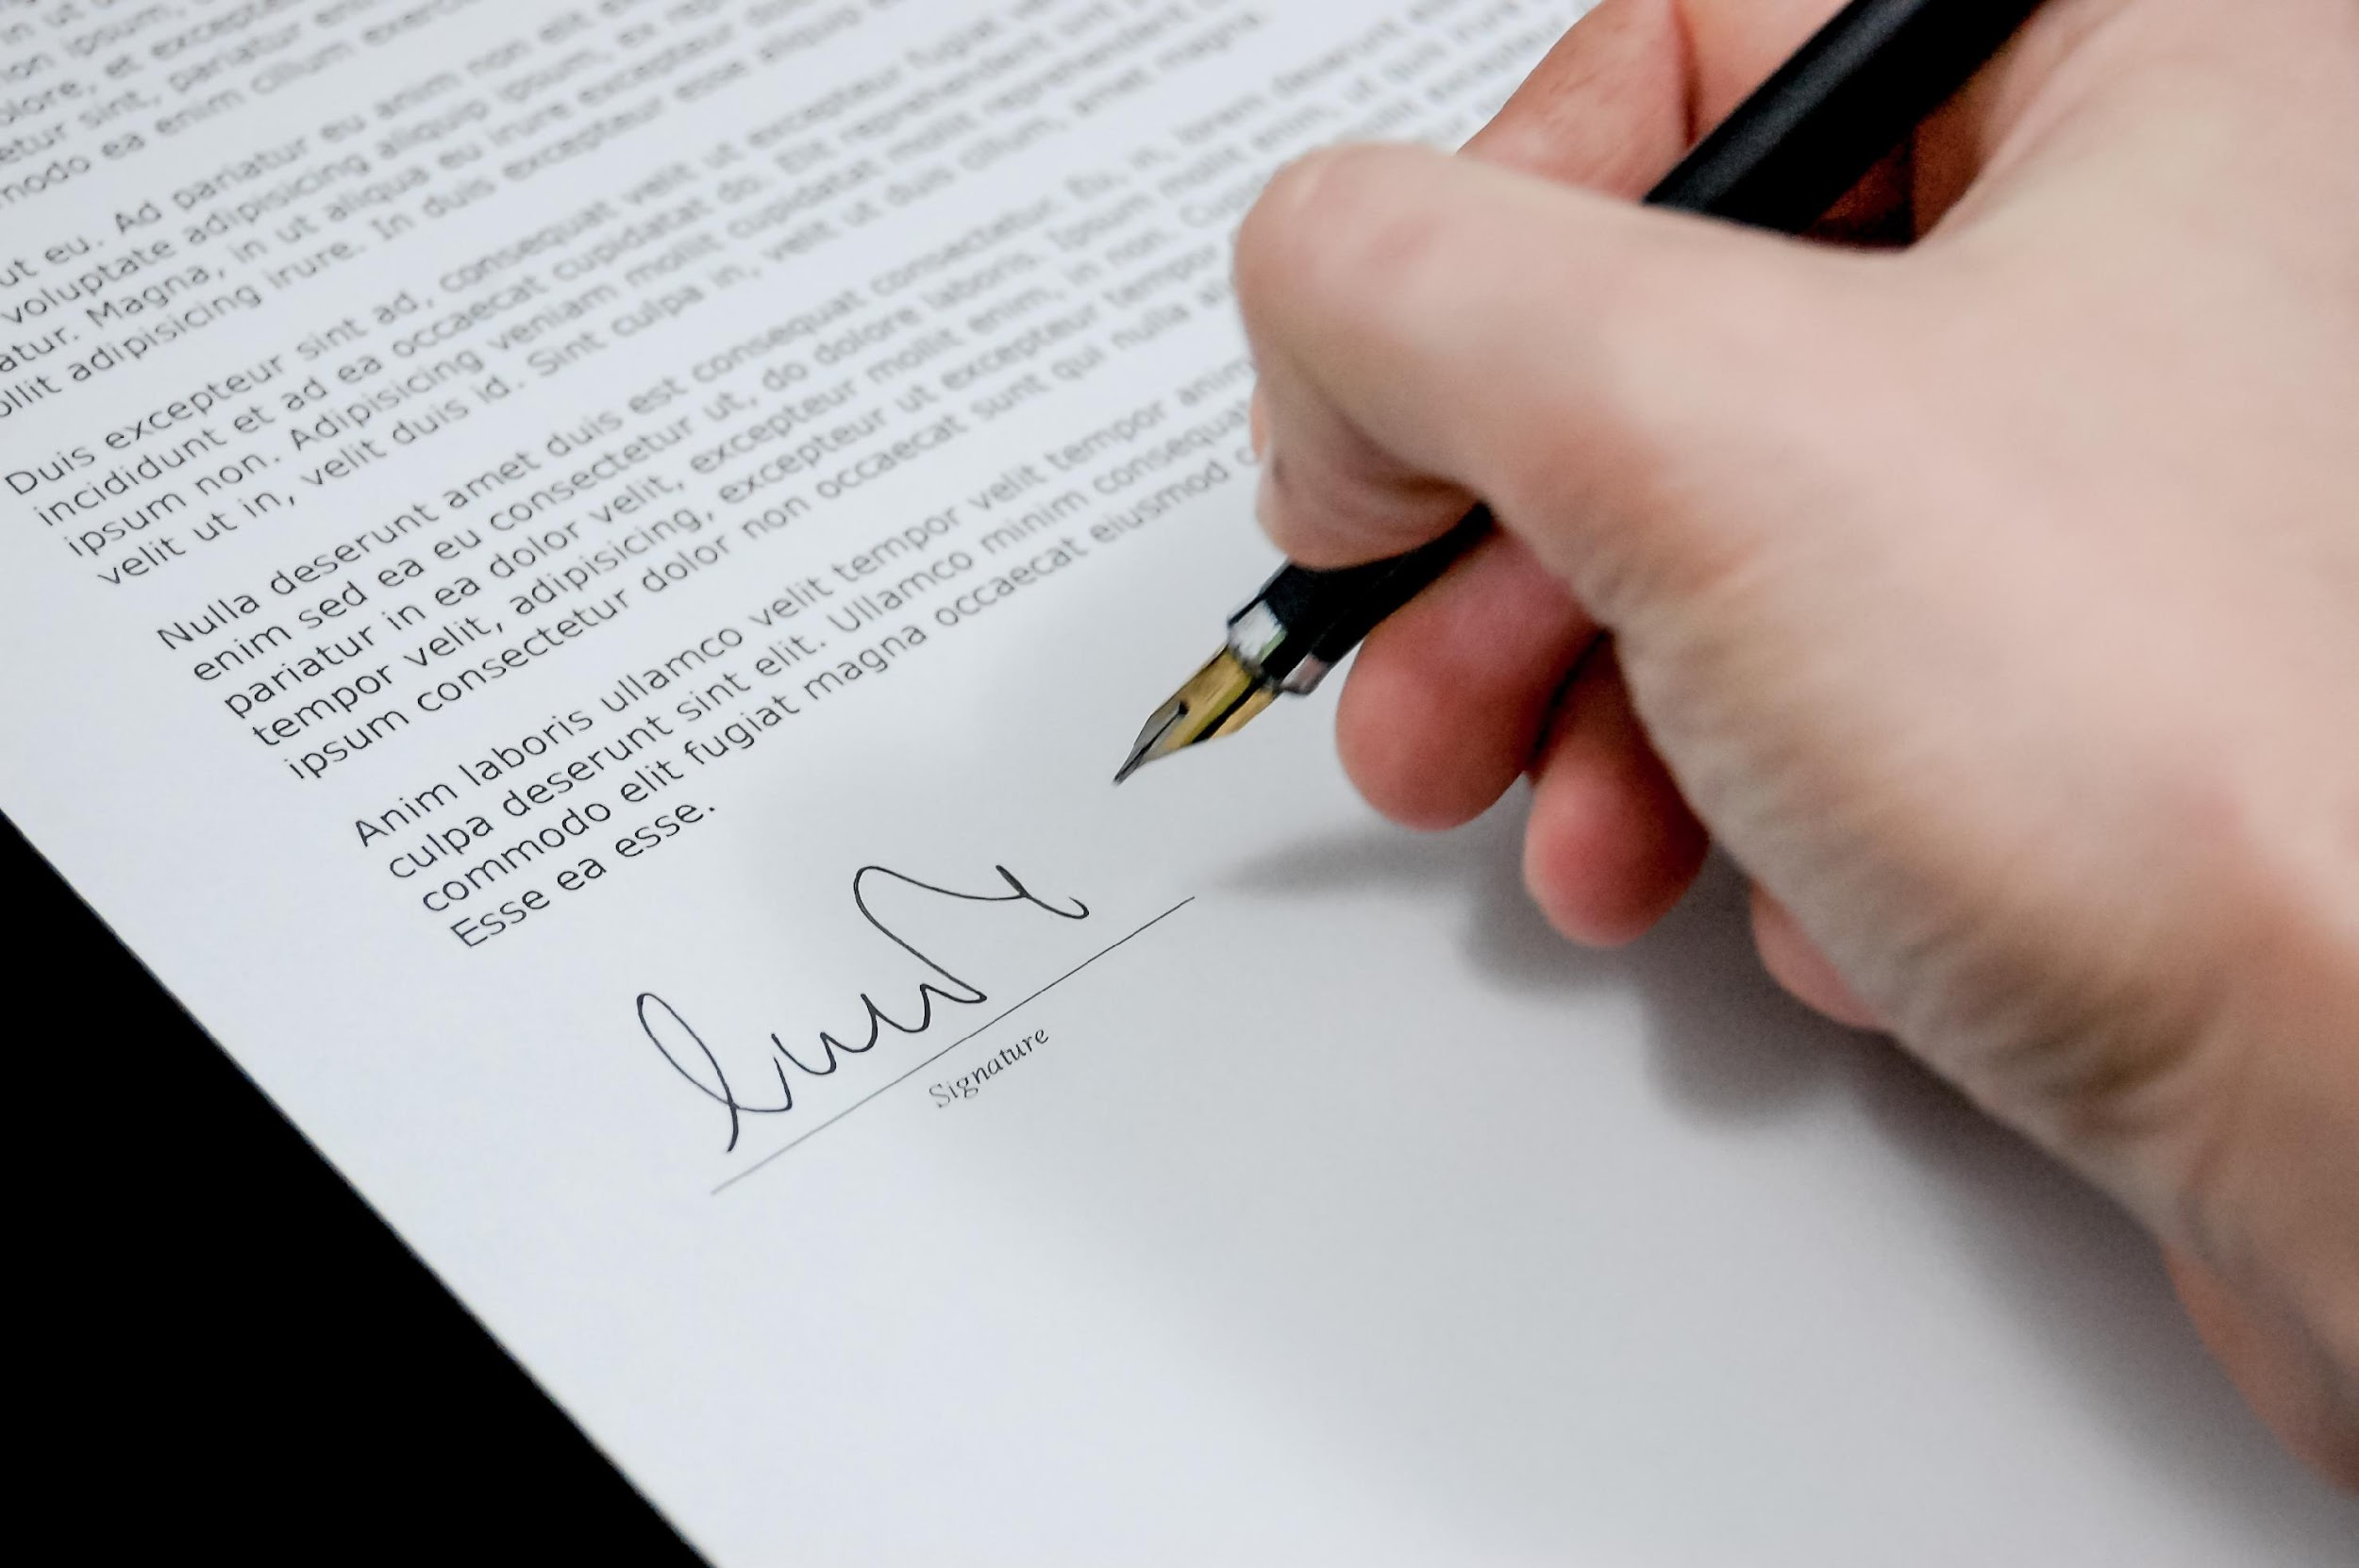
FUNDAMENTAL ASPECTS
Use and store data when consent is explicitly given
The GDPR says that each person, in specific circumstances, must provide her/his consent in a free way. “Freely given” consent essentially means you have not cornered the data subject into agreeing to you using their data. For one thing, that means you cannot require consent to data processing as a condition of using the service. People need to be able to say no.
612986-EPP-1-2019-1-DE-SPO-SCP

Slide 31
Moreover, the request for “consent shall be presented in a manner which is clearly distinguishable from the other matters” (Article 7 GDPR). It should be clear what data processing activities you intend to carry out, granting the subject an opportunity to consent to each activity.
Then, consent should be informed. This means that the data subject knows your identity, what data processing activities you intend to conduct, the purpose of the data processing, and that they can withdraw their consent at any time.
Lastly, consent must be unambiguous, namely, it “could include ticking a box when visiting an internet website, choosing technical settings for information society services or another statement or conduct which clearly indicates in this context the data subject’s acceptance of the proposed processing of his or her personal data.” (Recital 32 GDPR)
612986-EPP-1-2019-1-DE-SPO-SCP

Slide 32

In summary, you do not have valid consent and you can not use or store it in these cases:
you have any doubts over whether someone has consented;
the individual doesn’t realise they have consented;
you don’t have clear records to demonstrate they consented;
there was no genuine free choice over whether to opt in;
the individual would be penalised for refusing consent;
612986-EPP-1-2019-1-DE-SPO-SCP

Slide 33
there is a clear imbalance of power between you and the individual;
consent was a precondition of a service, but the processing is not necessary for that service;
the consent was bundled up with other terms and conditions;
the consent request was vague or unclear;
you use pre-ticked opt-in boxes or other methods of default consent;
your organization was not specifically named;
you did not tell people about their right to withdraw consent;
people cannot easily withdraw consent; or
your purposes or activities have evolved beyond the original consent.
612986-EPP-1-2019-1-DE-SPO-SCP

Slide 34

2. Enable all persons to view and access the data we keep and where it is processed and used
For organizations all sizes, hacking, data breaches, malware… can sometimes seem like there's a cybersecurity threat lurking around every corner and this represents a problems to users too. That’s why any organizations have to plan data store management strategies to make the data as secure and resilient as possible and to allow people to access them. In particular, the idea is that only users who are required to handle sensitive information have access to it, reducing the risk of it being mishandled by other users. This isn't a one-time job: organizations should be regularly reassessing who needs access to what data and what they need it for, especially if sensitive information is involved.
612986-EPP-1-2019-1-DE-SPO-SCP

Slide 35
- How to view and access to the personal data: anyone has right to ask for and obtain from the company/organization confirmation as to whether or not it holds any personal data which concerns him/her.
If they do have your personal data, then you have the right to access that data, be provided with a copy and get any relevant additional information (such as their reason for processing your personal data, the categories of personal data used, etc.).
This right of access should be easy and be made possible at reasonable intervals. The company/organization should provide a copy of your personal data free of charge. Any further copies may be subject to a reasonable fee. When the request is made by electronic means (for example through an e-mail), and unless otherwise requested by you, the information should be provided in a commonly used electronic form.
This right is not absolute: the use of the right to access your personal data should not affect the rights and freedoms of others, including trade secrets or intellectual property.
612986-EPP-1-2019-1-DE-SPO-SCP

Slide 36
- Where data are processed and used: after you give your consent, a processing phase starts in organizations’ databases. It covers a wide range of operations: “collection, recording, organisation, structuring, storage, adaptation or alteration, retrieval, consultation, use, disclosure by transmission, dissemination or otherwise making available, alignment or combination, restriction, erasure or destruction of personal data” (GDPR Article 4). Following some examples of processing:
staff management and payroll administration;
access to/consultation of a contacts database containing personal data;
sending promotional emails;
shredding documents containing personal data;
posting/putting a photo of a person on a website;
storing IP addresses or MAC addresses;
video recording (CCTV).
612986-EPP-1-2019-1-DE-SPO-SCP

Slide 37

3. Be clear about when and how data is processed and used
As written in GDPR Recital 39:
“[…] The principle of transparency requires that any information and communication relating to the processing of those personal data be easily accessible and easy to understand, and that clear and plain language be used.
That principle concerns, in particular, information to the data subjects on the identity of the controller and the purposes of the processing and further information to ensure fair and transparent processing in respect of the natural persons concerned and their right to obtain confirmation and communication of personal data concerning them which are being processed.
612986-EPP-1-2019-1-DE-SPO-SCP

Slide 38
(…) the specific purposes for which personal data are processed should be explicit and legitimate and determined at the time of the collection of the personal data.
The personal data should be adequate, relevant and limited to what is necessary for the purposes for which they are processed. This requires, in particular, ensuring that the period for which the personal data are stored is limited to a strict minimum. In order to ensure that the personal data are not kept longer than necessary, time limits should be established by the controller for erasure or for a periodic review.
Personal data should be processed only if the purpose of the processing could not reasonably be fulfilled by other means […]”
612986-EPP-1-2019-1-DE-SPO-SCP

Slide 39
How personal data are collected
Personal data in browsing histories: the digital history of the sites you’ve visited on your browser can take more than one form. Your browser can maintain its own log of the URLs of all the pages you’ve opened. Your browser’s cache will hold some of the actual page elements (like graphic images) and state information from those websites.
And online services like Google will have their own records of your history, both as part of the way they integrate your various online activities, and through the functionality of website usage analyzers that might be installed in the code of the sites you visit. Some of that data will be anonymized, making it impossible to associate with any one user. And some is, by design, traceable.
612986-EPP-1-2019-1-DE-SPO-SCP

Slide 40
E-commerce and social media Account data: every comment you’ve posted, every password you’ve entered, every transaction you’ve made and anything you bought is written to databases.
There are some concerning aspects to the ways our data is used. There's the possibility that your social media or online service provider might one day go “dark side” and abuse their access to your data. But also, many of them—perhaps most infamously, Facebook—have sold identifiable user data to external companies.
Moreover, not all servers are strong and can face cyberattacks.
Personal data in government databases: national and regional government agencies also control vast stores of data covering many levels of their citizens’ behavior.
612986-EPP-1-2019-1-DE-SPO-SCP

Slide 41
How personal data are used
Data collected by organizations can be used for profiling users and defining marketing strategies. Generally, servers process information on:
Geographical origin of the user;
Biographical and biological aspects (age, gender);
Values and personality elements;
level of education;
consumer behavior of the user.
The combination of these elements will allow the elaboration of statistics and the creation of user-targeted advertisements and thus expand the reach and promotion of an organization's services and products.
612986-EPP-1-2019-1-DE-SPO-SCP

Slide 42
4. Correct any identified errors as soon as this is practically possible
The GDPR includes the right to the ratification: “data subject shall have the right to obtain from the controller without undue delay the rectification of inaccurate personal data concerning him or her. Taking into account the purposes of the processing, the data subject shall have the right to have incomplete personal data completed, including by means of providing a supplementary statement” (Article 16 GDPR).
Your request to rectify your data should be addressed to the controller (the organisation/entity/administration/company processing your data) by email, letter, fax or through a form, as long as you have a written record of the request.
612986-EPP-1-2019-1-DE-SPO-SCP

Slide 43


5. Remove and “forget” data when requested
The GDPR governs also the so called “right to be forgotten”. In fact, users can ask to erase their personal data to an organization. In Article 17, the GDPR outlines the specific circumstances under which the right to be forgotten applies.
612986-EPP-1-2019-1-DE-SPO-SCP

Slide 44
An individual has the right to have their personal data erased if:
The personal data is no longer necessary for the purpose an organization originally collected or processed it.
An organization is relying on an individual’s consent as the lawful basis for processing the data and that individual withdraws their consent.
An organization is relying on legitimate interests as its justification for processing an individual’s data, the individual objects to this processing, and there is no overriding legitimate interest for the organization to continue with the processing.
An organization is processing personal data for direct marketing purposes and the individual objects to this processing.
An organization processed an individual’s personal data unlawfully.
An organization must erase personal data in order to comply with a legal ruling or obligation.
An organization has processed a child’s personal data to offer their information society services.
612986-EPP-1-2019-1-DE-SPO-SCP

Slide 45

The GDPR does not specify what a valid request to erasure entails. An individual can make a request for erasure verbally or in writing. This request can also be made to any member of your organization, not just to a designated contact.
612986-EPP-1-2019-1-DE-SPO-SCP

Slide 46
6. Respect each other’s privacy
The right to privacy is part of the 1950 European Convention on Human Rights, which states, “Everyone has the right to respect for his private and family life, his home and his correspondence.” From this basis, the European Union has sought to ensure the protection of this right through legislation.
Every individual values his privacy. Privacy is as important as respecting other people’s opinions. When you respect a person, you allow the person determine the limit of your involvement in his life.
612986-EPP-1-2019-1-DE-SPO-SCP

Slide 47
Privacy is important because:
gives you the power to choose your thoughts and feelings and who you share them with.
protects your information you do not want shared publicly (such as health or personal finances).
helps protect your physical safety (if your real time location data is private).
helps protect you as individuals, and your businesses, against entities you depend on or that are more powerful than you.
That’s why is fundamental to protect and respect users’ privacy and allow them to have control on it.
612986-EPP-1-2019-1-DE-SPO-SCP

Slide 48
REFLECT:
Were you aware of all these aspects?
Did you have a data management policy in your organization?.
Have you ever exercised one of these rights (for example, the right of ratification)?.
Imagine a cyberattack: what would they do? How would they inform their users?
612986-EPP-1-2019-1-DE-SPO-SCP

Slide 49
REFERENCES
Accademic articles and papers
Adrienn, L. (2016). What is Privacy? The History and Definition of Privacy. University of Szeged, Faculty of Law and Political Sciences, Department of Labour Law and Social Security and Sorbonne Law School Université Paris 1
Regulation (EU) 2016/679 of the European Parliament: https://eur-lex.europa.eu/legal-content/EN/TXT/PDF/?uri=CELEX:32016R0679
BEUC discussion paper, “Data collection, targeting and profiling of consumers online”, 2009.
612986-EPP-1-2019-1-DE-SPO-SCP

Slide 50
Websites and online articles
European Commission, How can I access my personal data held by a company / organisation?: https://ec.europa.eu/info/law/law-topic/data-protection/reform/rights-citizens/my-rights/how-can-i-access-my-personal-data-held-company-organisation_en
European Commission, What constitutes data processing?: https://ec.europa.eu/info/law/law-topic/data-protection/reform/what-constitutes-data-processing_enKeyHole
European Commission, What is personal data?: https://ec.europa.eu/info/law/law-topic/data-protection/reform/what-personal-data_en
FreeCodeCamp What Is Personal Data And Where Is it Stored?: https://www.freecodecamp.org/news/what-is-personal-data/
612986-EPP-1-2019-1-DE-SPO-SCP

Slide 51
GDPR.EU, Everything you need to know about the “Right to be forgotten”: https://gdpr.eu/right-to-be-forgotten/
GDPR.EU, Everything you need to know about the “Right to be forgotten”: https://gdpr.eu/right-to-be-forgotten/#:~:text=An%20individual%20has%20the%20right,that%20individual%20withdraws%20their%20consent.
Mamoto, Why is Privacy important? (Data Privacy Day): https://matomo.org/blog/2014/01/data-privacy-day-january-28th/
612986-EPP-1-2019-1-DE-SPO-SCP

