Slide 1


Financial Sustainability strategies and mechanism for Sport Organizations
Module 4
612986-EPP-1-2019-1-DE-SPO-SCP

Slide 2




Financial Sustainability strategies and mechanism for Sport Organizations
612986-EPP-1-2019-1-DE-SPO-SCP

Slide 3
Financial Sustainability strategies and mechanism for Sport Organizations
Introduction
Sustainable finance refers to the process of making investment decisions in consideration of the social, environmental and economic aspects in order to achieve a long-term sustainable business plan.
“Sustainability is seen as the capacity of maintaining social deliverables in time” (Paredes, M. et. al. 2019:6).
Paredes, M. et. al. (2019) support three main kinds of sustainability “making the impact of the organization’s work sustainable, ensuring continuity of funding, and making the organization itself sustainable to remain viable. Achieving all three creates a virtuous spiral” (p. 3).
Mechanisms of collaboration are desirable from both sides and result in mutual benefit, based on collaborative values and principles that include consistency, transparency and viability.
612986-EPP-1-2019-1-DE-SPO-SCP

Slide 4
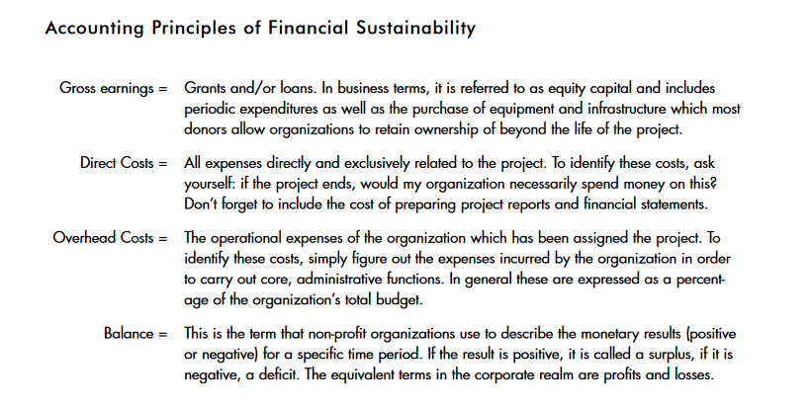
Financial Sustainability strategies and mechanism for Sport Organizations
Source: https://static1.squarespace.com/static/57e1f17b37c58156a98f1ee4/t/5ced77ffb208fca71e8cb821/1559066623740/four-pillars-financial-sustainability-tnc.pdf
612986-EPP-1-2019-1-DE-SPO-SCP

Slide 5
Financial Sustainability strategies and mechanism for Sport Organizations
FOUR PILLARS OF FINANCIAL SUSTAINABILITY
According to León, P. (2001:15-18), there are 4 pillars of financial sustainability presents as such: “1) Financial and Strategic Planning, 2) Income Diversification, 3) Sound Administration and Finance, 4) Own Income Generation”.
1st pillar: The organization MUST be aware from the beginning of not only its financial plan to attract investors, but also of its initial goals. No one is willing to invest in something that is not trustworthy, precise and well organized.
2nd pillar: For most fundraising schemes diversity and variety in income sources is considered as a valuable and fruitful move for future professional actions. Otherwise, the loss of an important investor(s) can cause damaging effects to the organization and even leading to its downfall (bankruptcy).
3rd pillar: Managing existing financial resources by specific procedures that result in generating income.
4th pillar: Ιncome that the organization decides how to spend.
612986-EPP-1-2019-1-DE-SPO-SCP

Slide 6

Financial Sustainability strategies and mechanism for Sport Organizations
Business Planning Process:
Attract investors/partners
To set initial goals to be achieved
To offer specific services that will benefit a part and/or a community
To thrive into the market competition
To find out more business opportunities
To prove yourself as a trustworthy partner organization
612986-EPP-1-2019-1-DE-SPO-SCP

Slide 7

Financial Sustainability strategies and mechanism for Sport Organizations
Financial Sustainability Strategy:
Saving & (Re) Investing profits
Initiative tool to boost the organization(s) character
Raising awareness
Maximizing shareholder’s value
Achieve long-term goals
Mutual Benefit => Successful Organization(s)
612986-EPP-1-2019-1-DE-SPO-SCP

Slide 8
Financial Sustainability strategies and mechanisms for Sport Organizations
Sport is recognized as an effective means for addressing public health and social issues.
Sport is a powerful economic engine that creates job opportunities, causes social changes and further develop a community through its impact.
Financial Sustainability Mechanisms:
Public funding (such as sports ministries)
Local authorities (municipalities & inter-communities)
Private financing (investing, employing, advertising etc.)
“Playing sports leads to the consumption of goods and services, but also has a considerable impact on industry, employment and the tertiary sector” (Pauna, 2020:953).
612986-EPP-1-2019-1-DE-SPO-SCP

Slide 9

Financial Sustainability strategies and mechanisms for Sport Organizations
Conclusion:
Necessity of the financing of sport organizations and their services, since they have a positive influence.
Public institutions should find an effective funding scheme for sport organizations that will benefit both sides.
Undoubtedly, sports bring proven assets to the population, and the financing of these activities can only be beneficial.
Both financial strategies and mechanisms play a vital supporting role for sport organizations in order to thrive into the market’s competition.
612986-EPP-1-2019-1-DE-SPO-SCP

Slide 10
References
León, P. (2001). FOUR PILLARS OF FINANCIAL SUSTAINABILITY. Resources for Success Series, volume 2, p. 1-29. Source: https://static1.squarespace.com/static/57e1f17b37c58156a98f1ee4/t/5ced77ffb208fca71e8cb821/1559066623740/four-pillars-financial-sustainability-tnc.pdf
Pauna, R. D., Pintea, A., Lazar, P. S., & Maier, D. (2020). The Effects of Financing Sports Activities on International Sports Performance and on the Population’s Health. International Journal of Academic Research in Business and Social Sciences. 10(10), p. 950-965. Source: https://hrmars.com/papers_submitted/7910/the-effects-of-financing-sports-activities-on-international-sports-performance-and-on-the-populations-health.pdf
Paredes, M. et. al. (2019). Key Determinants on Non-Governmental Organization’s Financial Sustainability: A Case Study that Examines 2018 FIFA Foundation Social Festival. Sustainability 2019, 11, 1411, p. 1-19. Source: https://mdpi-res.com/d_attachment/sustainability/sustainability-11-01411/article_deploy/sustainability-11-01411-v2.pdf
612986-EPP-1-2019-1-DE-SPO-SCP

Slide 11

Scouting sponsorship
612986-EPP-1-2019-1-DE-SPO-SCP

Slide 12
Introduction to sponsorship
What is sponsorship?
Sponsorship is a great financial source of additional revenue and contacts as well.
A company commits money or resources to a nonprofit organization for various promotional benefits.
The outcome of this sponsorship is to combine successfully marketing with social purpose goal(s).
According to the Sociologist Kunz (1969:666), sponsorship is considered to “include two defining elements: (1) the beneficiary organization retains its distinct boundaries from the sponsoring organization, and (2) the beneficiary organization legitimately makes use of the sponsoring organization’s facilities” .
Sponsorship is win-win process. Both the nonprofit and the for-profit organization/company benefit from the partnership, but the amount of success depends on their quality and quantity of working together.
612986-EPP-1-2019-1-DE-SPO-SCP

Slide 13

Introduction to sponsorship
Types of Sponsorship
The types of sponsorship vary according the needs and expectations of each organization. Therefore, these are the most common categories:
Financial Sponsorship (most common type among organizations for benefits exchange)
In-kind Sponsorship (includes goods or services exchange instead of cash)
Media event Sponsorship (social events promoting sponsor, advertisment)
Promotional Sponsorship (social media influencer sponsor)
612986-EPP-1-2019-1-DE-SPO-SCP

Slide 14

Introduction to sponsorship
How to get Sponsorship:
Introduce a clear and precise business plan
Keep it simple and short
Specify your social goal(s) to be achieved
Determine the importance of the sponsorship for the sport organization, based on your social purpose(s)
Look for potential and choose the one(s) that suits you best
Start a social campaign to further advertise your organization and focus on its mission
Define your targeted audience and keep its interest alive
Focus on your pitch sponsorship opportunity
Make your organization stand out from the rest ones
612986-EPP-1-2019-1-DE-SPO-SCP

Slide 15


Scouting sponsorship
Which are the roles of the sponsors:
According to the article of Scouts (2022), the sponsoring authority should provide the organization with the following:
Training events/seminars for all employees and members of the organization
Reqruitment of specialized members
Financial resources
Responsibilities
Minimum standards
Development of Scounting to give the fullest possible encouragement and assistance needed
Property and equipment preparation
Leadershipv
Social and economic development
612986-EPP-1-2019-1-DE-SPO-SCP

Slide 16

Scouting sponsorship
Scouting sponsors:
Online search
LinkedIn
Social Media
Expand your professional/personal contacts
Sponsor Sites
Referrals
Mailing lists
Corporate Social Responsibility Programs/Projects/Events
612986-EPP-1-2019-1-DE-SPO-SCP

Slide 17
Scouting sponsorship
Example of a Successful Sponsorship:
Based on Scouts’ article (2022), a nonprofit organization named “Boston Athletic Association” or “BAA” constitutes such an example since it benefits by:
“Receiving an incredible amount of financial resources coming from Adidas and other corporate sponsors
Raising the profile of their event as a world-class marathon by aligning themselves with brands (like Adidas)”
While Adidas benefits from this sponsorship through the organization’s targeted audience, which is mainly athletes and people actively involved in sports activities.
This example stresses the importance of mutual benefit between the sponsor and the organization(s).
612986-EPP-1-2019-1-DE-SPO-SCP

Slide 18
References
Kunz, R. P. (1969). Sponsorship and Organizational Stability: Boy Scout Troops. American Journal of Sociology. Vol. 74, No. 6, pp. 666-675. Published By: The University of Chicago Press.
Morand, T. (2021). How to Get Sponsorships: The Complete Guide. Source: https://www.wildapricot.com/blog/how-to-get-sponsorship
Paramasivam, H. (2019). How to Find Sponsors for Your Event? Dryfta Blog. Source: https://dryfta.com/10-ways-to-scout-sponsors-for-your-event/
SCOUNTS (2022). Community Sponsorship. Source: https://www.scouts.org.uk/volunteers/running-your-section/administration/community-sponsorship/
612986-EPP-1-2019-1-DE-SPO-SCP

