Slide 1
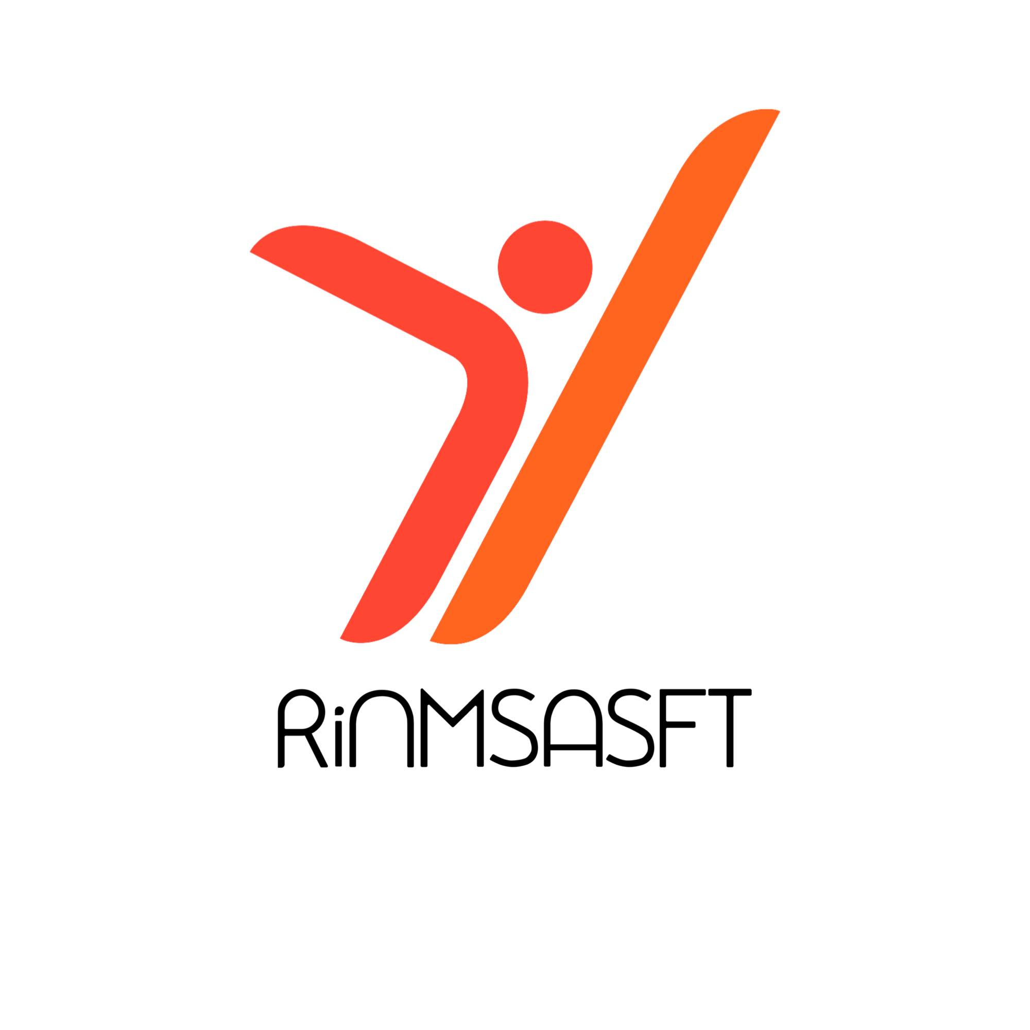

Crowdfunding Strategies
Module 5
612986-EPP-1-2019-1-DE-SPO-SCP

Slide 2
main types of crowdfunding models currently in use in the sport Field
Definition of Crownfunding
Crowdfunding (from crowd and funding) is a practice of bottom-up micro-financing “by raising small amounts of money from a large number of people” through a web platform. The digital factor is a key aspect for crowdfunding: higher is the number of backers and the amount of money collected, stronger will be the trust on the project itself, bringing more people (even our friends or community) to back it. Crowdfunding as a concept has created the opportunity for entrepreneurships to be able to raise money to invest in their business ideas, providing a tool to anyone with an idea and potential investors. The core mechanism is the active participation of the supporters who decide to invest: they not only appreciate what is proposed but also participate financially in the implementation. This creates a conversation between entrepreneurs and investors, a clear communication focused on concreteness. Crowdfunding is normally separated into different models depending on the donation flow and scope of the campaign, with the different models as the following: the donation based model, the pre-purchase model, the lending based model, the equity crowdfunding model.
A major issue that potential entrepreneurs that want to develop their idea through business plan is the lack of financial resources, with difficulties through fundraising with traditional ways, they face obstacles when trying to implement their ventures. Compared with other funding options (business angels or venture capital funds), crowdfunding offers some advantages for people wanting to raise funds, nowadays mainly based on the interaction facilitated by the online environment of the platforms or other social media (Belleflamme et al. 2014; Moritz and Block 2016). Nevertheless, the virtue of CF as a financial source has been highlighted by the literature as a phenomenon arising in the world of project financing and one of the most efficient methods to develop and finance innovative ideas.
612986-EPP-1-2019-1-DE-SPO-SCP

Slide 3
main types of crowdfunding models currently in use in the sport Field
The donation-based model : no legally binding financial obligation incurred by recipient to donor with no financial or material returns are expected by the donor.
The pre-purchase model: The pre-purchase crowdfunding model allows to sell the product before it was created..
The lending-based model : Debt-based transactions between individuals, mostly unsecured personal loans.
The equity crowdfunding model: Sale of registered security by mostly early-stage firms to investors.
612986-EPP-1-2019-1-DE-SPO-SCP

Slide 4
main types of crowdfunding models currently in use in the sport Field
The donation based model
Donation-based crowdfunding is the most preferred mode of fundraising. A person first creates the campaign and spreads awareness about his cause using social media and other forms of marketing, people supporting this cause is called as a donor. Any donor who relates to the cause is welcome to donate towards the campaign with no minimum or maximum amount for donation, willing to contribute as much he/she likes. Examples of donation-based crowdfunding platforms include Kickstarter, Indiegogo, CrowdFunder, and RocketHub. Donation-based crowdfunding platforms aimed at fundraising for charitable causes include GoFundMe, YouCaring.com, GiveForward, and FirstGiving. While the donation crowdfunding model can sometimes be used by innovative small startups, it is generally not suitable for a for-profit business start-up.
The donation-based crowdfunding is dived in two categories: personal campaigns and charity fundraising (Vargas, Dasari, and Vargas 2014). While personal campaigning involve an individual beneficiary or a small community looking for funds on a topic of its choice, charity fundraising involves a registered entity. For the first case, the beneficiary receives the collected funds only if the initial threshold has been met. In the second one, the beneficiary owns the funds even if below the threshold.
612986-EPP-1-2019-1-DE-SPO-SCP

Slide 5
main types of crowdfunding models currently in use in the sport Field
The donation based model : Pros
Community building: Donation-based crowdfunding campaign has the opportunity for donors to create bonds with the business or projects they support. The digital platform allows to keep track of how the money is being used, being transparent.
Social cause: By choosing to support specific project or individuals, donors are allowed to use their money to express their own views or opinions regarding specific topics.
Formalization of support: Donors who contribute to the campaigns of their relatives and friends may find it beneficial to use the platform to formalize their contribution (e.g., for tax purposes), allowing additional benefit of further risk-taking, because project failure may also negatively impact the social relationship (Lee and Persson 2012).
612986-EPP-1-2019-1-DE-SPO-SCP

Slide 6
main types of crowdfunding models currently in use in the sport Field
The donation based model : Cons
Fraud: The most obvious risk donors face is fraud with the risk of fake campaigns is particularly relevant when a campaign is not run by an official entity, such as a charity, that is often registered in a public register and subject to some minimum requirements.
Difficulties in raising funds: Compared to p2p lending or reward-based crowdfunding, backers neither receive any interest on their investment, nor do they receive rewards, therefore being hesitant to contribute to the project.
Advertising: Launching a campaign without proper advertising and marketing campaign for your project risks of a failure and not attract donors to support the project, as they give their contribution without expecting something in return.
612986-EPP-1-2019-1-DE-SPO-SCP

Slide 7
main types of crowdfunding models currently in use in the sport Field
The pre-purchased model
Pre-purchase is a hybrid model of reward-based and equity-based crowdfunding, in which the backers of a reward campaign obtain an option right on the subsequent issue of equity securities by the company launching the reward campaign. For this reason, in general, the regulations applicable to this type of fundraising coincide with those applicable to reward and equity crowdfunding.
In other words, in this model, the backer of a reward crowdfunding campaign can also enjoy, in the future, an option right on the subsequent issue of equity securities of the company he is financing, just by virtue of his purchase today of a product/service from that company. It goes without saying that, due to its characteristics, this model is not accessible to natural persons (individuals), but only to legal persons (companies/organisations).
612986-EPP-1-2019-1-DE-SPO-SCP

Slide 8
main types of crowdfunding models currently in use in the sport Field
The pre-purchased model : Pros
The pre purchased model allows to raise capital without having to pay it back or sharing equity, allowing as well to pre-sell your product or creative work, potentially funding the project before it is even created.
No collateral, credit check or previous business experience is needed with a simple process and moreover doesn’t require professional financial or legal help.
Exposure gained on the platform can help establish a customer base and brand awareness.
612986-EPP-1-2019-1-DE-SPO-SCP

Slide 9
main types of crowdfunding models currently in use in the sport Field
The pre-purchased model : Cons
Since this model is based on individual donations, pre-purchased model is not suitable for businesses seeking large amounts of funding, having for consequences to forfeit any amount raised
Any project that can create interesting and valuable rewards will find its place in pre-purchased Crowdfunding. Creating the right rewards is a challenge and not every project can do it, but if you can, you should take advantage of this type of crowdfunding.
612986-EPP-1-2019-1-DE-SPO-SCP

Slide 10
main types of crowdfunding models currently in use in the sport Field
The lending-based model
In lending-based crowdfunding (also referred to as peer-to-peer lending or social lending), investors supply funds to individuals, groups or small companies, expecting to be reimbursed after a given period, generally with interest rates, without the involvement of traditional financial intermediaries (Guo et al. 2016). The lending-based model is the model that expands the most worldwide—half of the platforms operate under this model (Rau 2017).
Different categories of lending crowdfunding can be distinguished:
• P2P lending where individual funders lend to individual fundraisers and entrepreneurs. In many cases, the loan is unsecured. Based on the information disclosed by the fundraiser, funders decide to cover all or a certain amount of the requested loan sum (Savarese 2015). If the campaign is successful, the loan is disbursed to the fundraiser, and later repaid with interest to the funder(s).
• Peer-to-business (P2B) lending where individual funders lend to SMEs. The loans are not secured. Speed, flexibility, and cost (Savarese 2015) make P2B lending a viable business funding alternative13 that is attractive mostly for start-ups, small enterprises with growth potential.
• Business-to-business (B2B) lending where the funder is made up of different businesses—often very small companies—that want to lend money for good rates of return. Lending to businesses (both P2B and B2B) may also involve funding of pooled investment vehicles instead of individual businesses.
612986-EPP-1-2019-1-DE-SPO-SCP

Slide 11
main types of crowdfunding models currently in use in the sport Field
The lending-based model : Pros
Access to capital at a lower cost: The use of innovative algorithms to determine the creditworthiness of applicants, streamlined application and approval processes, and specialization in a limited number of products and services allow platforms to operate with a relatively low infrastructure cost, which reduces the cost of the loan to the fundraiser, although this may not necessarily be true for all platforms. Platforms may also create incentives for traditional financial institutions to innovate (European Commission 2016a).
Different sources of funding: The selective process on traditional capital providers after the financial post-crisis (IMF 2016) have reduced the demands of personal loans to fund projects (EBA 2016, OECD 2014, OECD 2009), making lending crowdfunding a suitable alternative than traditional lending.
Financial return: Lending model allows a larger return for investors, equality to a higher risk. Specifically, it enhances the demand from funders who want an exponential return and accept the higher risks than comes with it, compared to the traditional services proposed by banks.
612986-EPP-1-2019-1-DE-SPO-SCP

Slide 12
main types of crowdfunding models currently in use in the sport Field
The lending-based model : Cons
Financial loss: Despite its advantages with higher reward, the risk is higher due to the nature of unsecured loans to individual consumers, SMEs, and start-ups. In addition, credit assessment methods used by platforms are largely new and untested through the credit cycle. To mitigate this risk, some platforms have established a provision fund (a contingency/reserve fund) or introduced third-party guarantees.
Campaigning costs: As planning a crowdfunding can be costly as consequential resources are needed, fundraisers seek others ways and opportunity when possible. In addition, and specifically with regard to entrepreneurs, crowdfunding works well for a one-off injection of capital, not necessarily for longer-term or ongoing support.
Illiquidity: With equity crowdfunding, there may be little or no secondary market for related investments. Equity itself can be difficult to assess. Investors can find it difficult to sell once they make an investment, and even if it is possible, they may have to liquidate their position with a significant loss. The value of issued shares may be diluted by further issuance.
612986-EPP-1-2019-1-DE-SPO-SCP

Slide 13
main types of crowdfunding models currently in use in the sport Field
The equity model
Equity crowdfunding is crowdfunding model based on raising money online from investors to fund private companies. In exchange of the funding, the investor receives shares and equity of the company. Equity crowdfunding is an online platform where companies create profiles that include their products and financial information. The crowdfunding platform can charge a percentage of the funds raised for the service. Many charge a monthly listing fee. Some will charge an additional fee for payment processing. You may also need to pay for services such as bookkeeping to organize your documents.
Equity crowdfunding is not the same as reward crowdfunding, where supporters receive rewards (often products or services) in exchange for donations. Equity Crowdfunding differs from other types of small business financing in that it does not include a debt component. Instead of paying with a business loan, you sell your company's stock to investors. Some websites allow you to sell your company's stock only to accredited investors who are people of a certain income level.
612986-EPP-1-2019-1-DE-SPO-SCP

Slide 14
main types of crowdfunding models currently in use in the sport Field
The equity model : Pros
Global reach. Equity Crowdfunding provides access to funders around the world. This is especially relevant for countries with underdeveloped capital markets.
Equity crowdfunding allows to raise large amounts of money quickly. Once you and your lawyer have configured your stock offering and selected a platform, you can move from underfunded to fully funded within a few weeks. Usually, you need to approach each investor individually and present your ideas. This can take several years.
Controlling of the company rather than having an investor who may want to join your board and have a say in your company's decisions. Also, since investors are co-owners who share the company's success, we have a dedicated team of trademark lawyers from the beginning. This means a team of people who share their brand with the network and build brand loyalty while raising product awareness.
612986-EPP-1-2019-1-DE-SPO-SCP

Slide 15
main types of crowdfunding models currently in use in the sport Field
The equity model : Cons
Equity crowdfunding is that it can result in lower quality investments than instead from traditional sources such as venture capitalists and angel investors. The general public is inexperienced in business and investment and usually does not reach the net worth of accredited investors, so they do not benefit from the huge capital and business advice often provided by many investors.
Numbers of investors who are interested in your company. Staying in touch and develop a clear communication strategy to enable them to continue to support the brand, even if it may take years for them to make a financial profit is crucial
Time consuming, creating compelling presentations that include marketing plans, financial forecasts, and even videos that convey the value of your ideas.
612986-EPP-1-2019-1-DE-SPO-SCP

Slide 16
References
Stephanie A. Macht, & Jamie Weatherston. (2014). The Benefits of Online Crowdfunding for Fund-Seeking Business Ventures. Research Gate. https://www.researchgate.net/publication/264716517_The_Benefits_of_Online_Crowdfunding_for_Fund-Seeking_Business_Ventures
C. MONDELLI, Che cos'è il crowdfunding, Fundraising Digitale, 16/01/2017
Y.-C.L., & C.-H.Y. (2016). Improving Donation Distribution for Crowdfunding : An Agent-Based Model.
Kim, H., & de Moor, L. (2017). The Case of Crowdfunding in Financial Inclusion : A Survey. Strategic Change, 26(2). https://doi.org/10.1002/jsc.2120
Donation-Based Crowdfunding Definition. (2019, août 12). Investopedia. https://www.investopedia.com/terms/d/donationbased-crowd-funding.asp
Bernardino, S., & Santos, J. F. (2020). Crowdfunding : An Exploratory Study on Knowledge, Benefits and Barriers Perceived by Young Potential Entrepreneurs. Journal of Risk and Financial Management, 13(4). https://doi.org/10.3390/jrfm13040081
R. DE LUCA, Il crowdfunding: quadro normativo, aspetti operativi e opportunità, Fondazione Nazionale dei Commercialisti, 2015, cit., p. 5
612986-EPP-1-2019-1-DE-SPO-SCP

Slide 17
crowdfunding campaigns in the field of sport
Introduction
A precise objective to be reached, a limited time to achieve it and the need to team up with other fellow adventurers, there are many points of contact between sport and a crowdfunding campaign. But how can crowdfunding be used to implement a sports project? How can a sports association involve its community of supporters in order to achieve a shared goal together? Apart from the funds raised, what other benefits can a club gain from such an experience?
At the heart of every crowdfunding campaign is a concrete goal to be achieved: acquiring new equipment, improving sports facilities, organising tournaments and events, starting new courses, buying transport and much more. Athletes, teams and clubs can use crowdfunding to find the resources they need to overcome many challenges with the help of their community.
For a sports organisation, fundraising is an opportunity to work as a team with fans, athletes, families and sponsors to achieve a goal together, to communicate its activities, launch new disciplines, consolidate and expand its membership and supporter base.
612986-EPP-1-2019-1-DE-SPO-SCP

Slide 18
crowdfunding campaigns in the field of sport
PORDENONE 2020 : Un club nel Club – Equity Crowdfunding
"Pordenone 2020", an equity crowdfunding project unique in Italy, was born in 2018. In view of the Centenary Pordenone Calcio creates a club within the club: the fans, by purchasing a share, become an active part of the development process of the black and green society. A process based on the values of transparency and participation, with the aim of strengthening the club - in view of the Centenary - by further raising the level of the First Team (promoted to Serie B), the Youth Sector (a national model and reference point for the territory) and the facilities.
The equity crowdfunding campaign, launched on the new platform TheBestEquity, aimed to raise funds to allow Pordenone Calcio to grow, including by forming the Pordenone of the future at home. In particular with the aim of enhancing a sports centre of excellence and a corporate philosophy focused on the enhancement and development of its young people.
The minimum membership fee was of 250 euros. There are three types of technical participation: category C (250-5,000 euros), category B (5,001-25,000 euros) and category A (over 25,000 euros). In addition to the technical benefits (first and foremost, full administrative rights, guaranteed for all shares), there are exclusive advantages, again modulated on the basis of the size of the shares. Advantages such as season tickets, reduced entrance fees, merchandising and special discounts.
The campaign was launched the end of 2018 till summer 2019. At the dedicated "Pordenone 2020" office at the Bruno De Marchi sports centre. Pordenone 2020 has ended with 254 new members of the club, reaching the goal established of 2 million 200 thousand euros.
612986-EPP-1-2019-1-DE-SPO-SCP

Slide 19
crowdfunding campaigns in the field of sport
Sporteams – A start-up case study
Sporteams, an innovative Italian startup in the sportech sector, announced the start of an equity crowdfunding campaign on the “Two Hundred” crowdfunding platform: the aim is to accelerate the process of the 4.0 digital revolution of Italian sport at youth, amateur and amateur level. Sporteams is an innovative startup founded in Florence in November 2018 with the aim of offering digital services for the youth and amateur sports world with a SaaS (Software as a Service) model.
A few days after its launch, Sporteams' equity crowdfunding campaign has convinced a large number of investors who, thanks to their participation, have allowed the operation to exceed the minimum fundraising target of €100,000. The equity crowdfunding campaign on the Two Hundred platform ended on the 14th of May 2022, launched with the aim of accelerating the startup's growth, it has a maximum subscription target of €500,000. Depending on the level of fundraising achieved, Sporteams - which had a pre-money valuation of around €5 million - will be able to make investments of up to around €1.23 million over the three-year period 2021-2023, of which around €520 thousand will be earmarked for research and development with the aim of offering its customers increasingly technologically advanced services.
612986-EPP-1-2019-1-DE-SPO-SCP

Slide 20
crowdfunding campaigns in the field of sport
Golee – A sucessful sport startup
Golee, the innovative startup founded to accelerate digital transformation in a sector populated by 14,000 amateur and non-amateur football clubs, is not stopping and a few days ago launched its crowdfunding campaign on Backtowork, where it aims to raise half a million euros. Golee's target customers are amateur sports clubs and their stakeholders (95% of the sports market). These stakeholders highlight the difficulty of accessing accessible technological solutions and are forced to opt for a predominantly paper-based management.
The start-up provides digital services for sports clubs: from administrative management and activity monitoring for coaches, managers and athletes to the creation of e-commerce and dedicated websites. Golee is currently the digital partner of more than 160 sports clubs and is therefore used by around 15,000 athletes and 500 coaches in the four main Italian regions in terms of number of members: Lombardy, Piedmont, Emilia Romagna and Tuscany.
Golee's campaign follows the closing of a €1.3 million round in February 2021, of which €500,000 was raised through the equity crowdfunding campaign on BacktoWork and the rest represented by a contribution from Invitalia's Smart & Start programme and the Research & Development Tax Credit. This was the third round for Golee, which had cashed in another €850,000 in November 2019 ,previously, in September 2018, Golee had raised a €150k round. In total, the startup has so far raised €2.4 million from investors.
612986-EPP-1-2019-1-DE-SPO-SCP

Slide 21
References
PORDENONE 2020, UN CLUB NEL CLUB | Pordenone Calcio. (2019). Pordenone Calcio. https://www.pordenonecalcio.com/pn2020/
Buzz, C. (2019, 8 juillet). Successo record per il Pordenone calcio : 2,2 milioni raccolti con equity crowdfunding. Crowdfunding Buzz. https://www.crowdfundingbuzz.it/successo-record-per-il-pordenone-calcio-2-milioni-raccolti-con-equity-crowdfunding/
R. (2019, 21 juin). Pordenone, crowdfunding concluso : raccolti 2,2 milioni. Calcio e Finanza. https://www.calcioefinanza.it/2019/06/20/pordenone-crowdfunding-concluso/
R. (2021, 25 mars). Equity Crowdfunding : una raccolta fondi per il nostro progetto sportech. SPORTEAMS. https://www.sporteams.it/blog/digitalizzazione/equity-crowdfunding-digitalizzazione-sport/
R. (2021b, mars 25). Sporteams, equity crowdfunding per la digitalizzazione delle società dilettantistiche. ToscanaInDiretta. https://www.toscanaindiretta.it/sport/2021/03/25/sporteams-equity-crowdfunding-per-la-digitalizzazione-delle-societa-dilettantistiche/115508/
F. (2020, 27 novembre). Un calcio al Covid : tutti i nuovi progetti di Golee, l’app che gestisce le società sportive. Forbes Italia. https://forbes.it/2020/11/30/golee-app-gestire-societa-sportive-via-crowdfunding/
Magri, V. (2022, 3 février). La sportech Golee lancia equity crowdfunding da 800 mila euro sulla piattaforma rumena SeedBlink, alla prima campagna per una startup italiana. BeBeez. https://bebeez.it/crowdfunding/la-sportech-golee-lancia-equity-crowdfunding-da-800-mila-euro-sulla-piattaforma-rumena-seedblink-alla-prima-campagna-per-una-startup-italiana/
612986-EPP-1-2019-1-DE-SPO-SCP

